Slide 1
Areas of Opportunity - Transit Accessibility Project

Slide 2
PURPOSE
To empower the City of Birmingham and its partner agencies with new strategies, community energy, and implementable projects that leverage public and private investment, bringing new hope and renewal to communities that have faced poverty and decline for far too long.

Slide 3
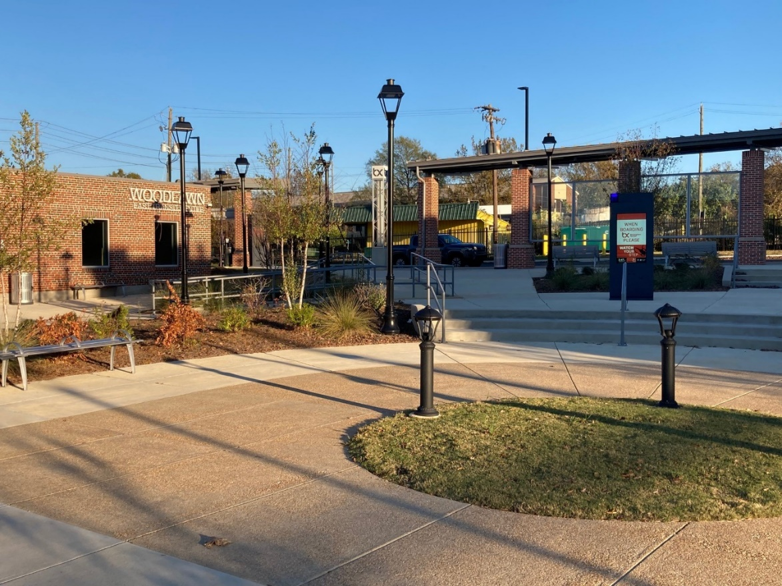
ALTERNATIVES AND PARTNERSHIPS
Prepare alternatives considering six strategies to holistically address poverty.
Economic Development
Community Advocacy
Affordable Housing
Quality of Life
Multi-modal Connections
Transit

Slide 4
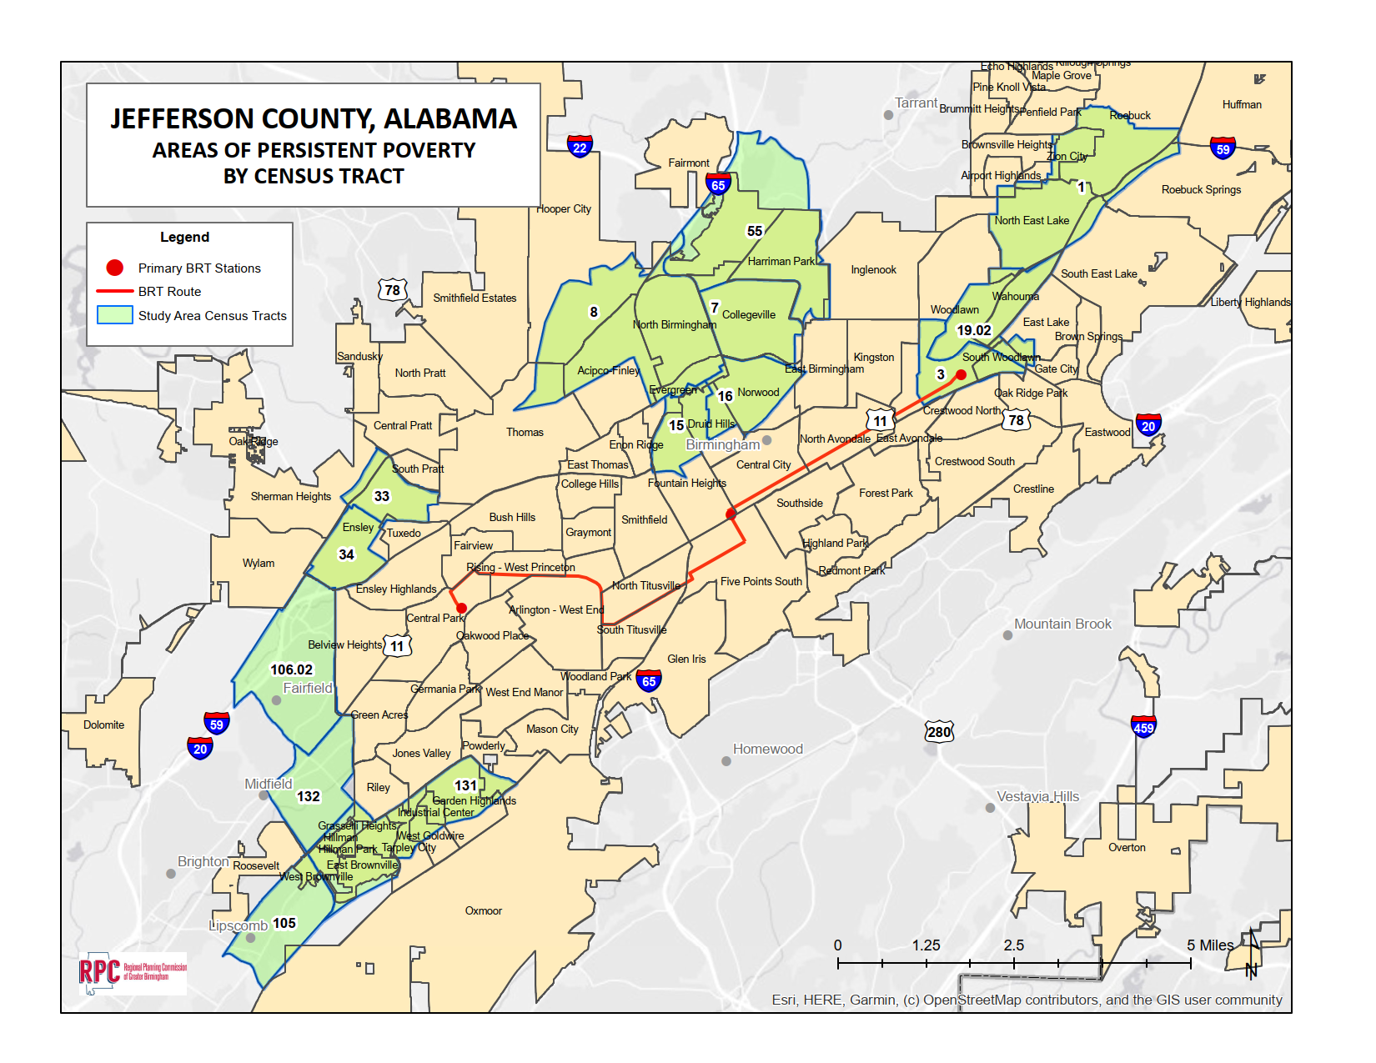
STUDY AREA

Slide 5
PROJECT TIMELINE
Project will be performed in 3 stages
Stage 1* – Challenges and Opportunities
6 - 8 months
Stage 2* – Alternatives and Partnerships
6 – 8 months
Stage 3* – Implementation Initiatives
3 - 5 months
Full Project Timeline 18 months
* Public and Stakeholder Engagement will be continuous over the course of the project

Slide 6
PROJECT DELIVERABLES
Identify challenges for areas of persistent poverty
Evaluate existing transit services
Review existing and future conditions for multi-modal transportation
Offer land use, equitability, accessibility and sustainability recommendations
Develop transit alternatives
Support RPCGB, BJCTA and the cities of Birmingham, Fairfield, Midfield, and Lipscomb to take maximum advantage of grant opportunities
Notes:
PRODUCT
Analyze historical data and identify challenges for areas of persistent poverty
Evaluate existing transit services
Review and assess existing and future conditions for multi-modal transportation
Offer land use, equitability, accessibility and sustainability recommendations
Develop transit alternatives
Support RPCGB, BJCTA and City of Birmingham to take maximum advantage of grant opportunities

Slide 7
COMMUNITY CONNECTIONS
Community Connections are the Key!
WHO ARE WE MISSING?

Slide 8
CURRENT INITATIVES
Region | Birmingham-wide | Community / Neighborhood
Safe Streets and Roads for All (SS4A) Regional Transportation Plan | Imagine Birmingham (2013 Comp Plan) Prosper Initiative Reconnecting Communities Grant / Transit Capital Investment Plan | North Birmingham Framework Plan Eastern Area Framework Plan Western Area Framework Plan City Center Master Plan
What else?
Notes:
Group should volunteer someone to make notes
Group should volunteer someone to share out ideas and feedback

Slide 9
EXSISTING CONDITIONS

Slide 10
POPULATION DENSITY

Slide 11
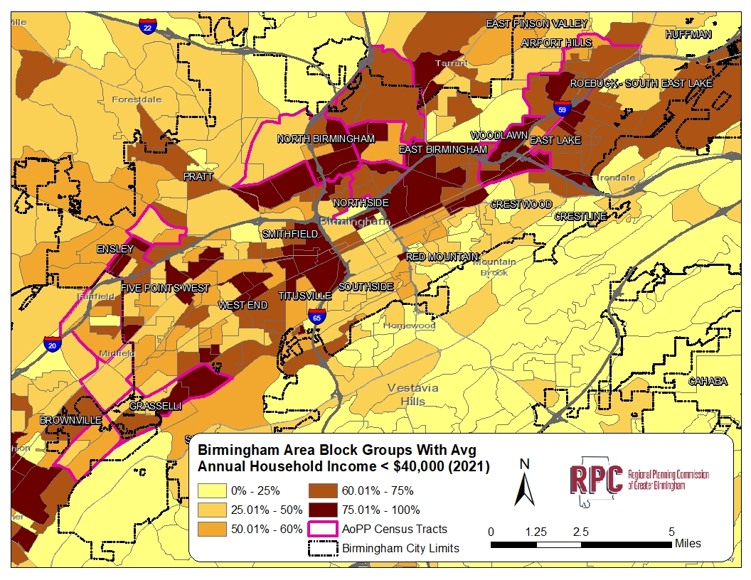
AVERAGE HOUSEHOLD SALARY

Slide 12
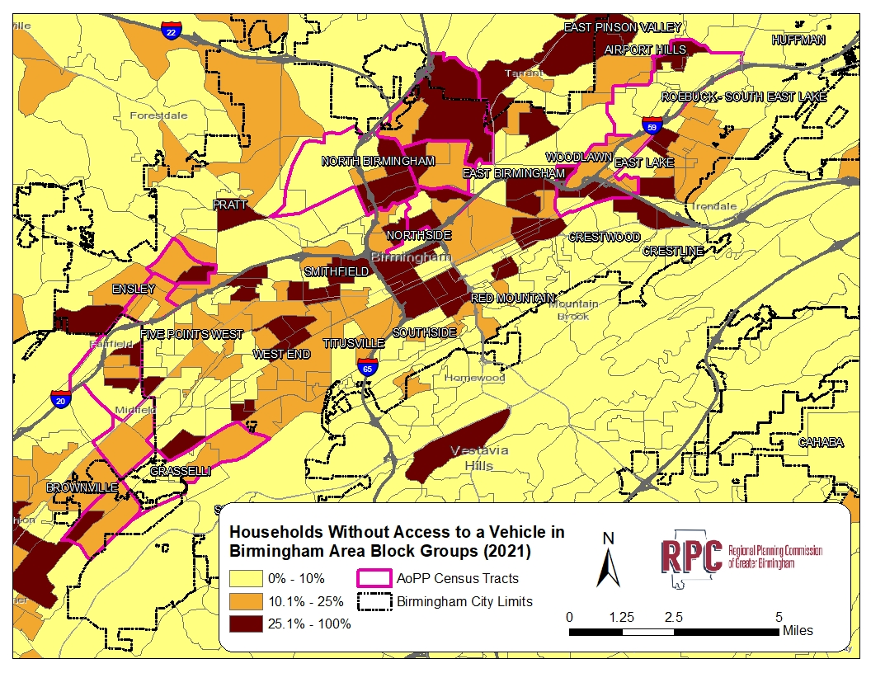
HOUSEHOLDS WITHOUT VEHICLE ACCESS

Slide 13
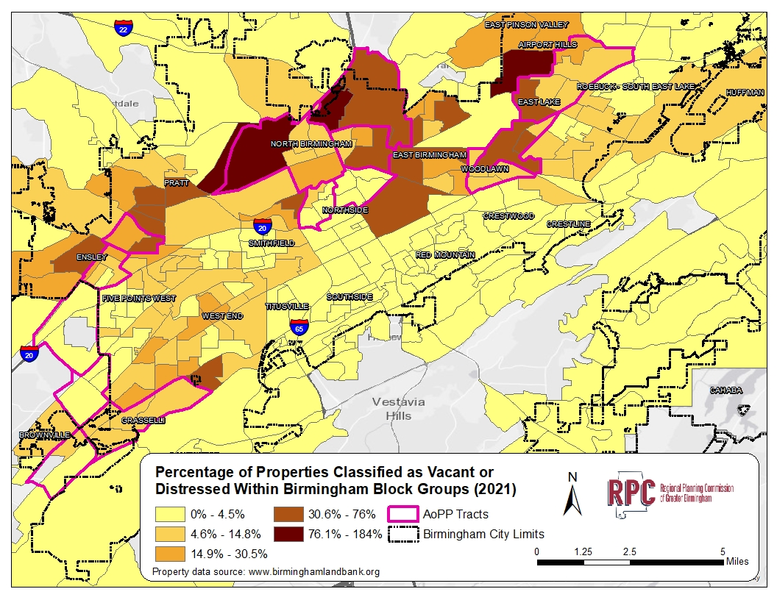
VACANT OR DISTRESSED HOMES

Slide 14
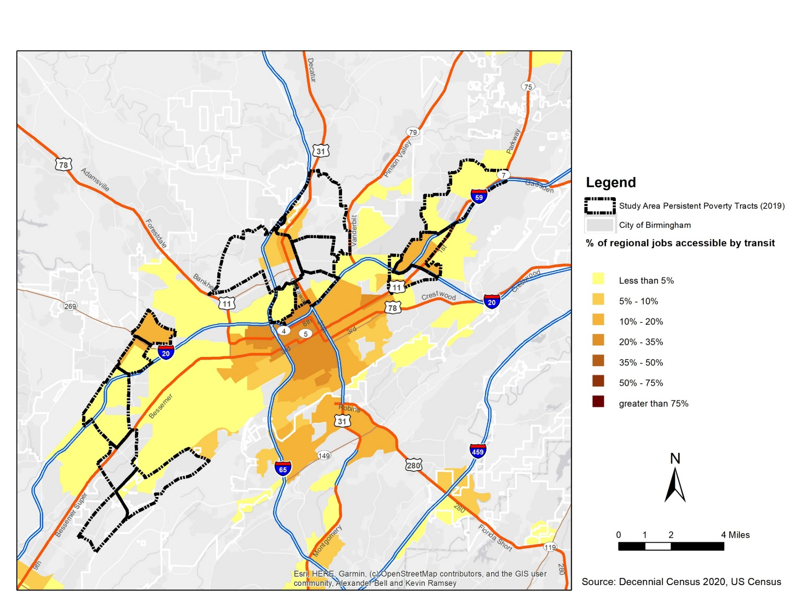
EMPLOYMENT ACCESSIBLE BY TRANSIT

Slide 15
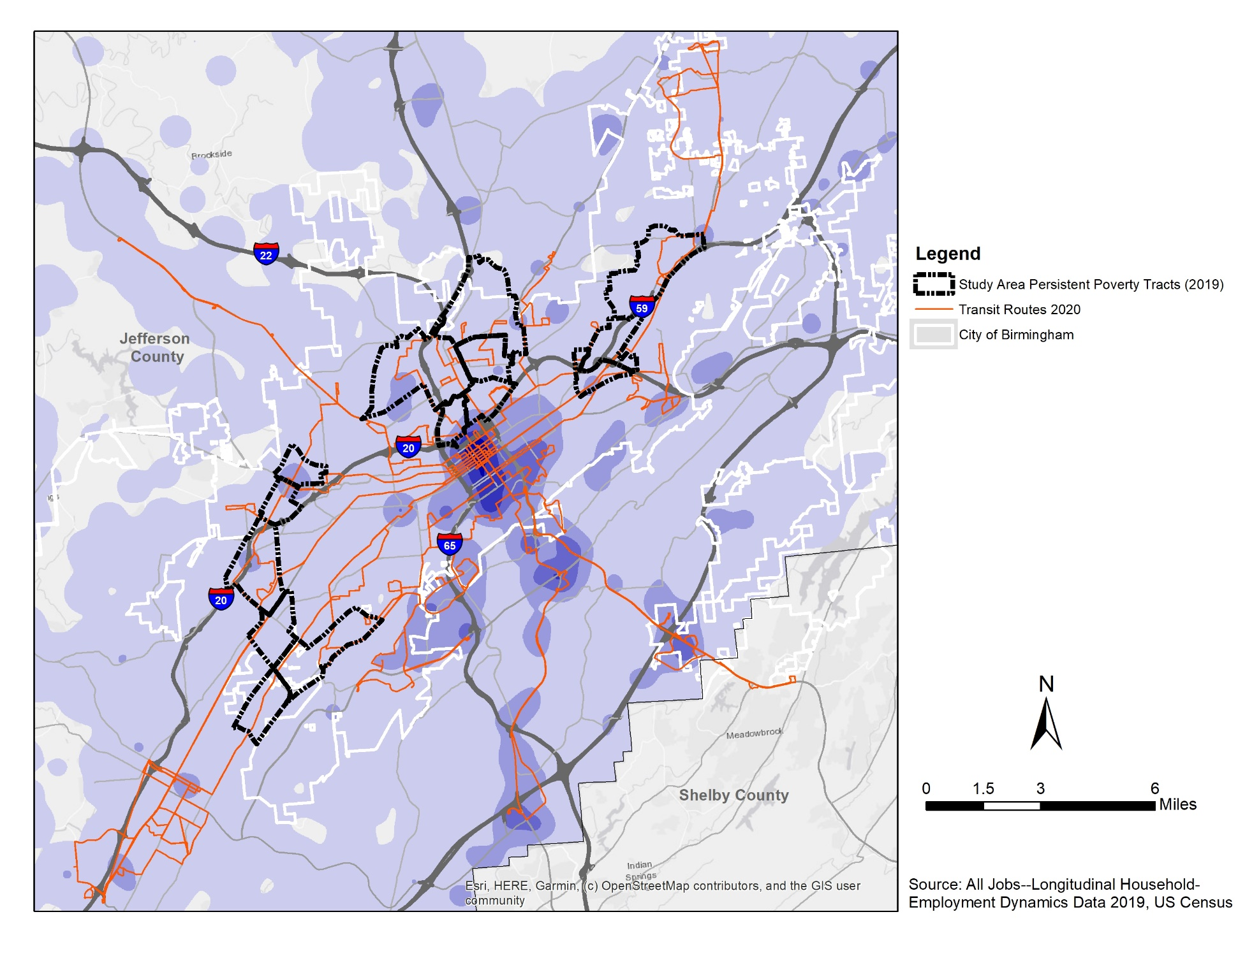
EMPLOYMENT DENSITY
Density of All Jobs, 2019 (Jefferson County)
5 – 1,993 jobs/ sq. mile
1,994 – 7,959 jobs/ sq. mile
7,960 – 17,901 jobs/ sq. mile
17,902 – 31,821 jobs/ sq. mile
31,822 – 49,718 jobs/ sq. mile

Slide 16
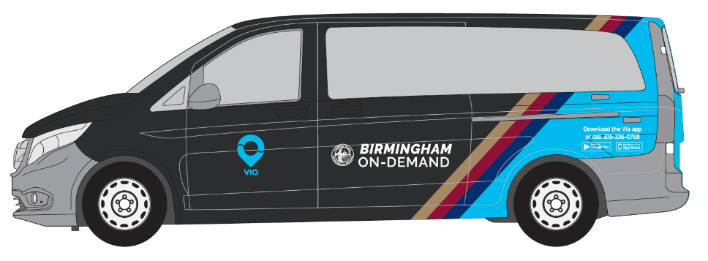
AVAILABLE TRANSIT OPTIONS
BJCTA
- 21 Fixed Routes
Paratransit
Birmingham Express (BRT)
Via
- Microtransit (on demand)

Slide 17
OTHER TRANSPORTATION
Micromobility
E-Bikes
Scooters
Roadways
Items that Prohibit or Promote Transportation Access
I – 65
Airport
Railroad

Slide 18
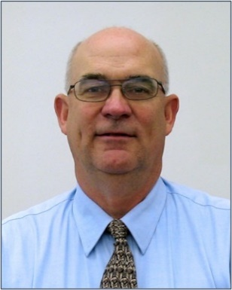
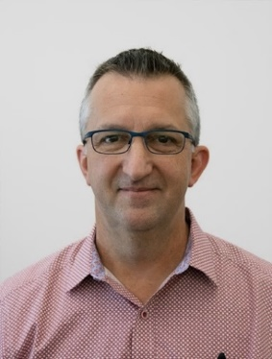
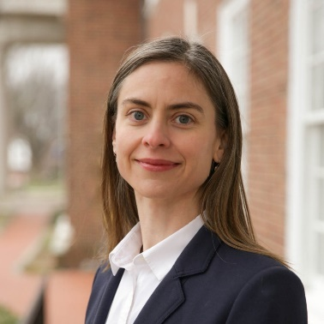
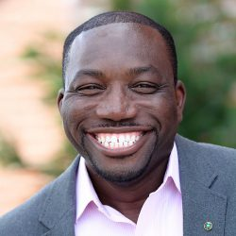
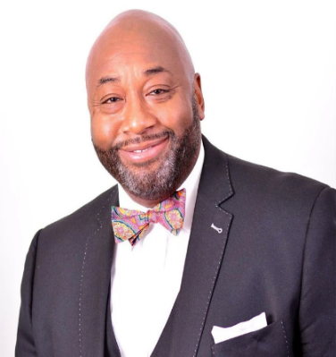
PROJECT TEAM
Whitman, Requardt & Associates – Atlanta and Baltimore
Dynamic Civil Solutions, Inc. – Birmingham
Creative Directions, Inc. – Birmingham
Johnson Management Group - Birmingham
Jim Ritchey
WRA
Tim Preece
WRA
Monica
White - Mark
WRA
Andrea Trabelsi
WRA
Bolaji Kukoyi
Dynamic Civil Solutions
Jana White
Creative Directions
Valton Johnson
Johnson Management
Group

Slide 19
THANK YOU

